Slide 1
Capstone Engagement
Assessment, Analysis, and Hardening of a Vulnerable System

Slide 2
Table of Contents
This document contains the following sections:
01
Network Topology
02
Red Team: Security Assessment
03
Blue Team: Log Analysis and Attack Characterization
Hardening: Proposed Alarms and Mitigation Strategies
04

Slide 3
Network Topology
‹#›

Slide 4
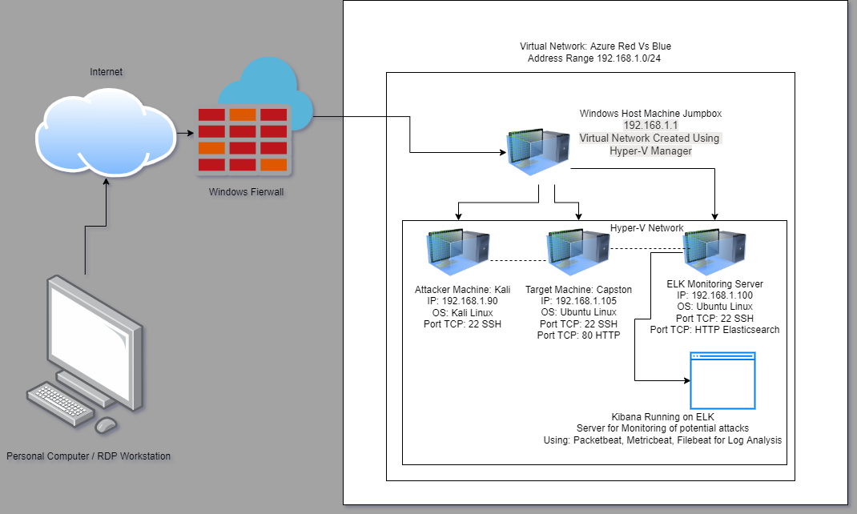
Network Topology
[Insert Here]
Use draw.io to create a diagram of the network.
Add your diagram to this slide and fill out the data in the sidebar.
Network
Address Range:
Netmask:
Gateway:
Machines
IPv4:
OS:
Hostname:
IPv4:
OS:
Hostname:
IPv4:
OS:
Hostname:
IPv4:
OS:
Hostname:

Slide 5

Red Team
Security Assessment
‹#›

Slide 6
Recon: Describing the Target
Nmap identified the following hosts on the network:
Hostname | IP Address | Role on Network
ML-RedVm-684427 | 192.168.1.1 | NATSwitch, hosts other Virtual Machines through Hyper-V, functions as a Jumpbox
Kali | 192.168.1.90 | Attacking machine, used to find and exploit vulnerabilities on Capstone Machine
Capstone | 192.168.1.105 | Target machine, running a vulnerable apache webserver
ELK | 192.168.1.100 | Monitoring server, running Kibana to collect data from Capstone

Slide 7
Vulnerability Assessment
The assessment uncovered the following critical vulnerabilities in the target:
Vulnerability | Description | Impact
Usernames are easily obtainable | Several usernames on the system are only first names | Usernames can be easily found based on public company information, allowing for easier exploit
Passwords are weak | Passwords have no security requirements, can be 1 single word, no requirement for numbers or special characters | Attackers can quickly crack passwords using common wordlists and bruteforce attacks
Bruteforce Password Attack | Passwords do not have a limit on attempts, allowing for hydra and other programs to run many password combinations automatically | Using a wordlist like rockyou.txt, attackers can gain access quickly to user accounts due to use of weak passwords, and common 1 word passwords being use
Open Port 80 CVE-2019-6579 | Allows access to the webserver by the public, giving potential to execute commands with admin privileges. This can also be accessed by port 443 in some cases | Allows access to webserver and public users can locate files that were meant to be secret, as well as what was intended to be shown

Slide 8
Vulnerability Assessment
The assessment uncovered the following critical vulnerabilities in the target:
Vulnerability | Description | Impact
Shell Access | Gaining access to a shell on the webserver using a payload uploaded to the webserver | This allows the attacker to open a remote shell on the target machine, gaining access to information available on that machine
Access to Root user | Once access is gained to the webserver, an attacker can switch into a root user, essentially giving full access to the system | An attacker can copy, download, change, upload, or delete almost anything on the system once root privileges are accessed
Password Hash | Passwords have unsalted hashes that are easily cracked by crackstation.net or john the ripper | Password hashes are stored on easily accessible files, and once found, they can be easily cracked allowing access further into the system with more potential compromises to the system
Sensitive username/password info stored in other accounts | Multiple usernames and password/password hash combinations can be found in other user accounts | An attacker can easily leverage this into access to many user accounts, allowing them to potentially escalate privileges, or locate other import information

Slide 9
Vulnerability Assessment
The assessment uncovered the following critical vulnerabilities in the target:
Vulnerability | Description | Impact
Webdav CVE-2018-15137 | Webdav is vulnerable if unsecured and can allow for a shell to be created by an attacker. | Attackers can use webdav to access and change things on a webserver if not properly set up
Easily accessed directory information | Information on the ‘secret’ directory is easily accessible, as well as the ip address to access files that should not be publicly accessible | An attacker can access information that is not supposed to be public facing, allowing potential compromise of data, or other usernames and passwords if they are listed on these systems

Slide 10
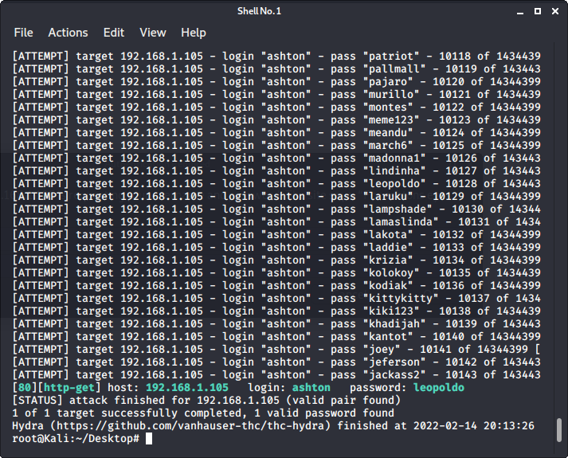
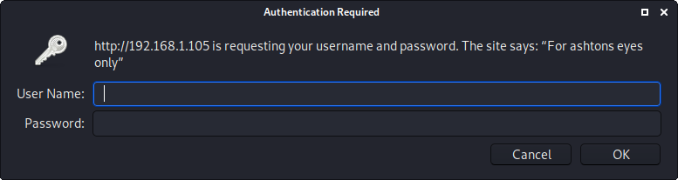
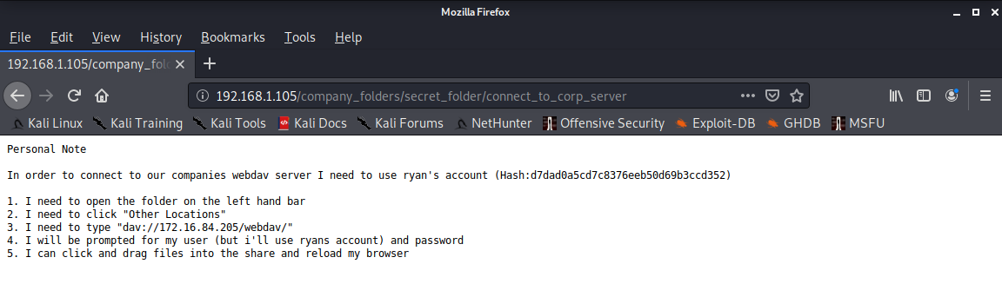
Exploitation: BruteForce attack
01
02
03
Tools and Processes
Once the basic username was found for the user ‘ashton’ it was any easy process to use the pre-installed HYDRA program on Kali to run a large number of potential passwords from the rockyou.txt wordlist to locate Ashton’s password
Achievements
This exploit cracked Ashton’s password, allowing for the attacker to gain access to Ashton’s account. This also gave access to a file containing the username and password hash for the user Ryan

Slide 11
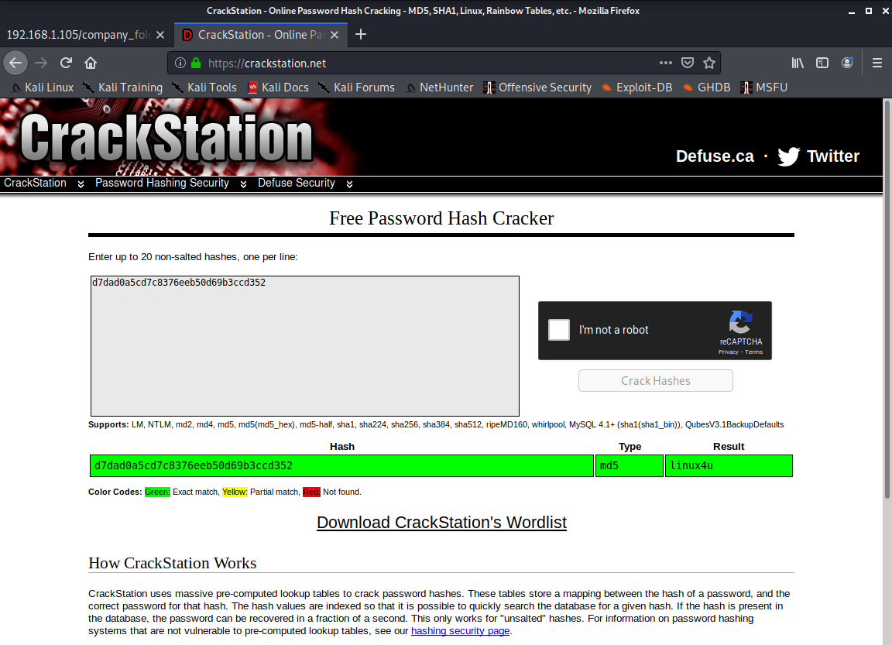
Exploitation: Password Hash
01
02
03
Tools & Processes
Once the hash for Ryan’s password was located on the “For Ashton’s eyes only” page, the password was easily cracked using crackstation.net, this could also be achieved using John the ripper or other similar programs available for linux
Achievements
This gave access to Ryan’s user account, this gave further privileges in the system and allowed for access to Webdav, which was exploitable in uploading files directly to the webserver. This revealed that the hash for Ryan’s account revealed from Ashton was cracked to ‘linux4u’

Slide 12
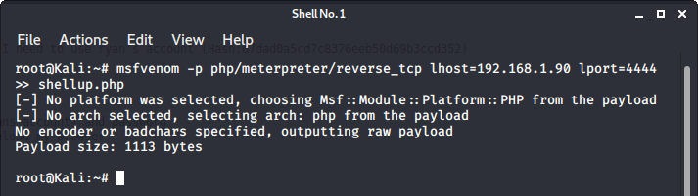
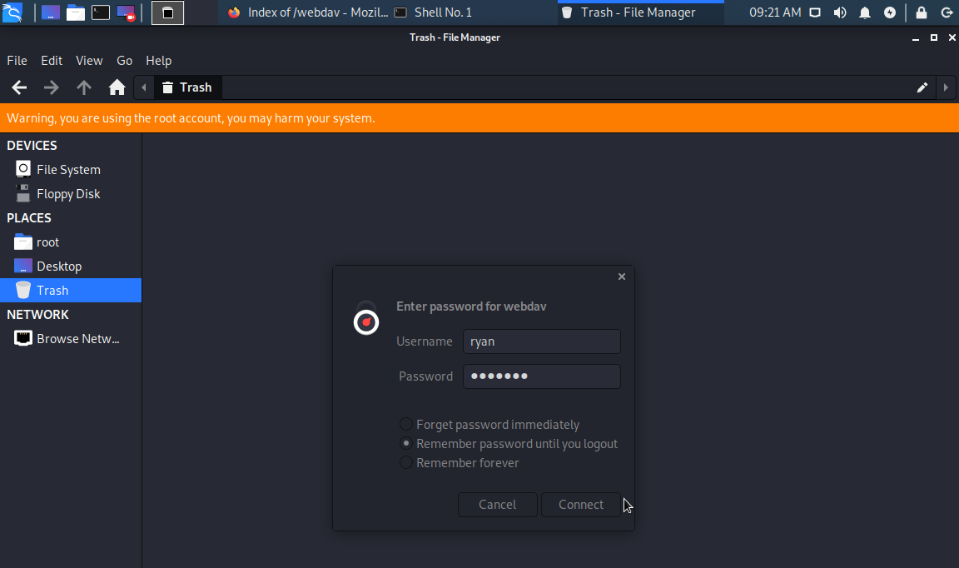
Exploitation: Webdav
01
02
03
Tools & Processes
Once access was gained to Ryan’s account, Webdav became accessible to exploitation. Using msfvenom, a payload was created that was then uploading to the vulnerable directory on the webserver. This was accessed through the file folder on Kali, in the webdav folder, once access was gained.
Achievements
This allowed for the msfvenom payload file (named shellup.php) to be added to the web directory. This payload set up a listener on the webserver that allows for easy shell access to the server through metasploit
giving access to sensitive files and establishing root access to the system

Slide 13
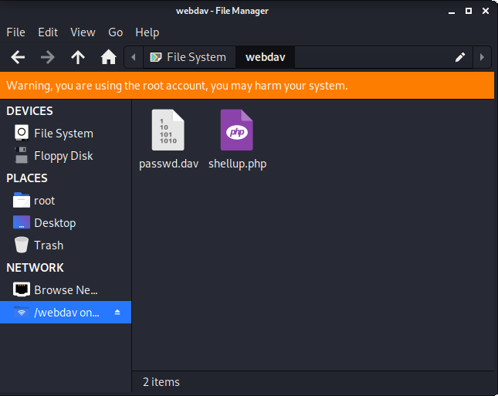
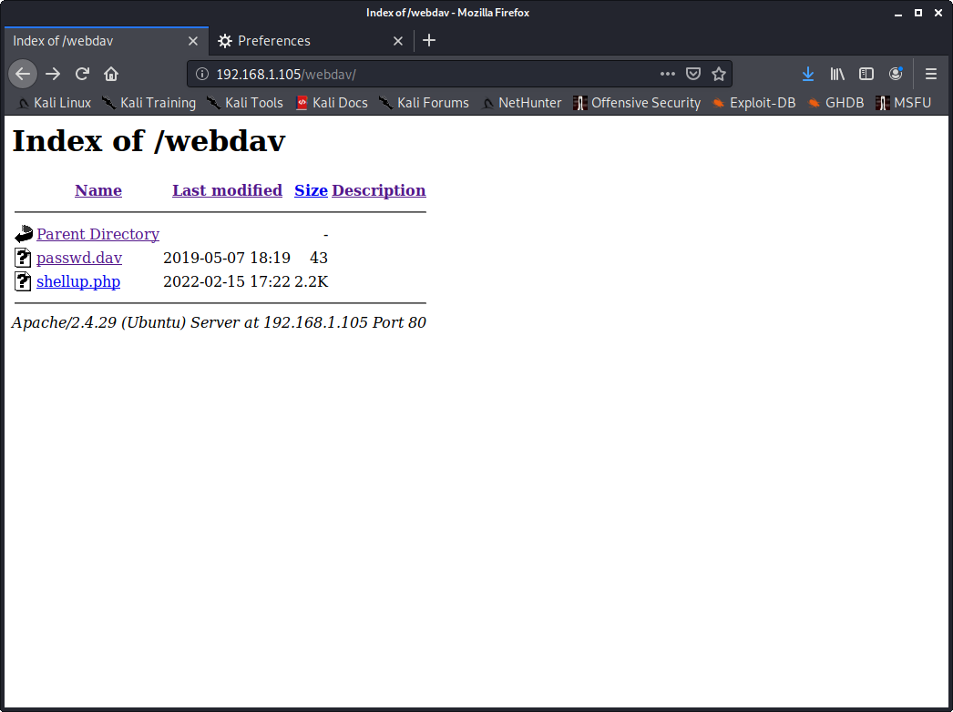
Exploitation: Webdav screenshots Part 2
03

Slide 14
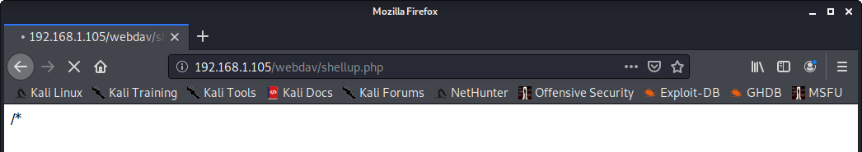
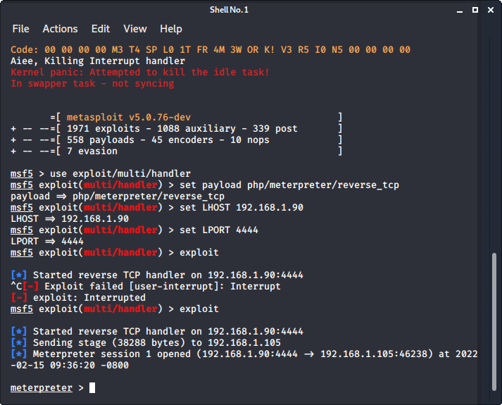
Exploitation: Shell Access
01
02
03
Tools and Processes
Once the msfvenom payload was created an uploaded, the payload can be run from the webserver to give meterpreter shell access to the attacker through Metasploit program.
Achievements
Once a meterpreter shell is established, it can be used to move freely about the webserver files and directories. This will allow for location of the hidden flag within the system, as well as other sensitive files and materials that can potential compromise the company.

Slide 15
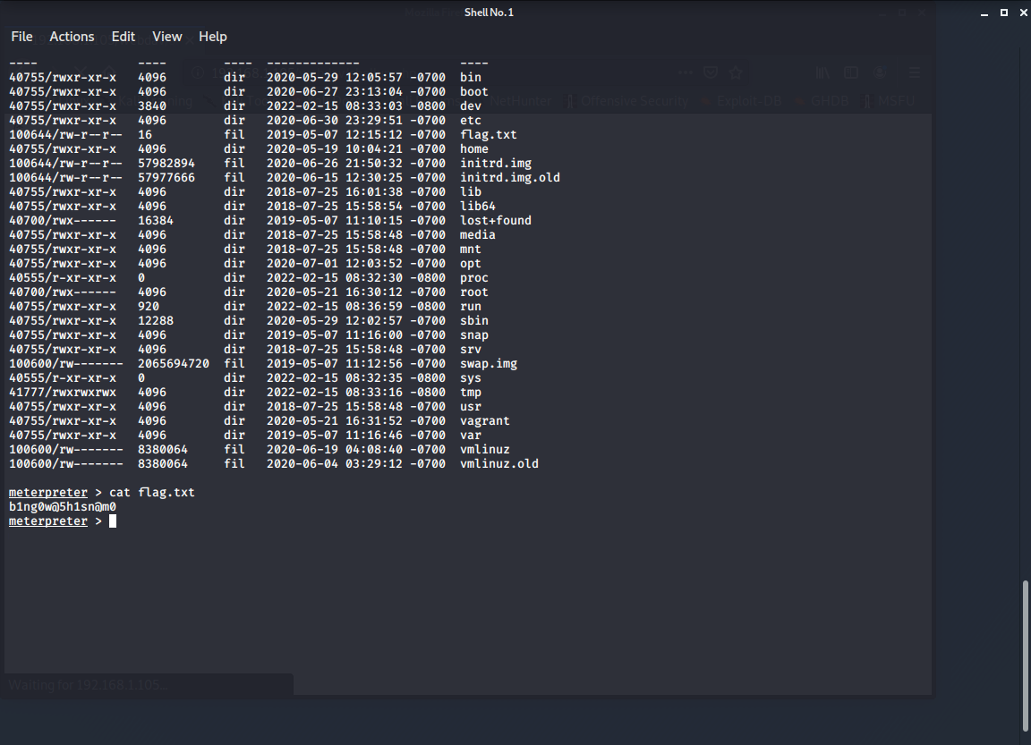
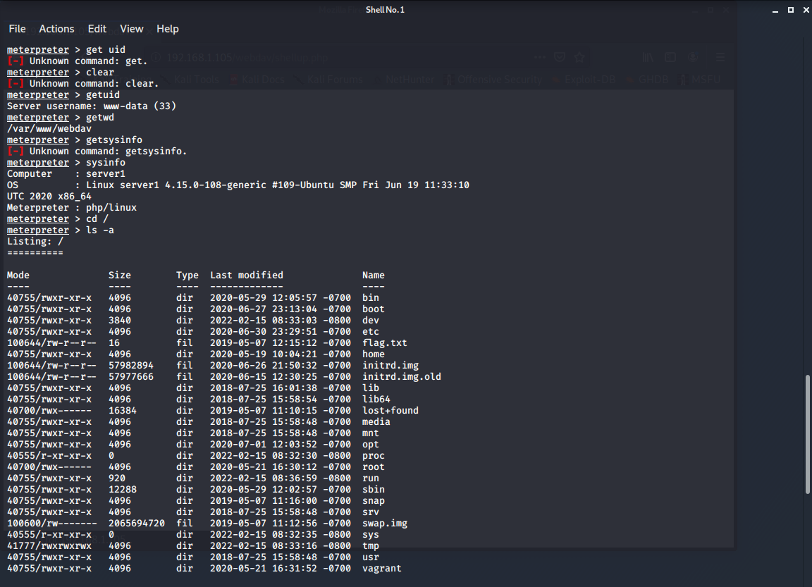
Exploitation: Shell Access Part 2
03

Slide 16

Blue Team
Log Analysis and Attack Characterization
‹#›

Slide 17

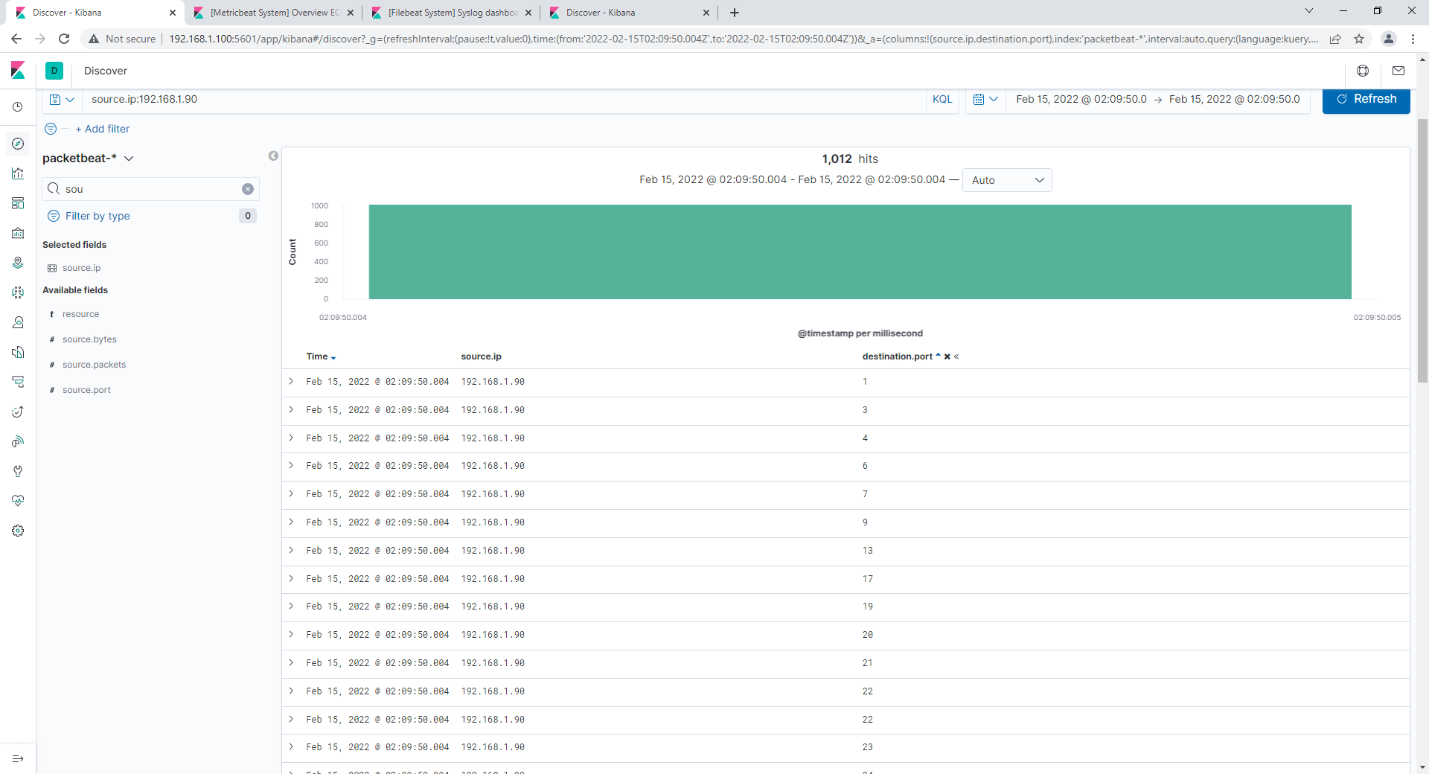
Analysis: Identifying the Port Scan
The Port scan occurred at 02:09:50 UTC on 2/15/2022
There were 1012 Packets sent from 192.168.1.90
The destination ports indicate a port scan, as packets were sent to each possible port on the webserver to test for any that were open

Slide 18
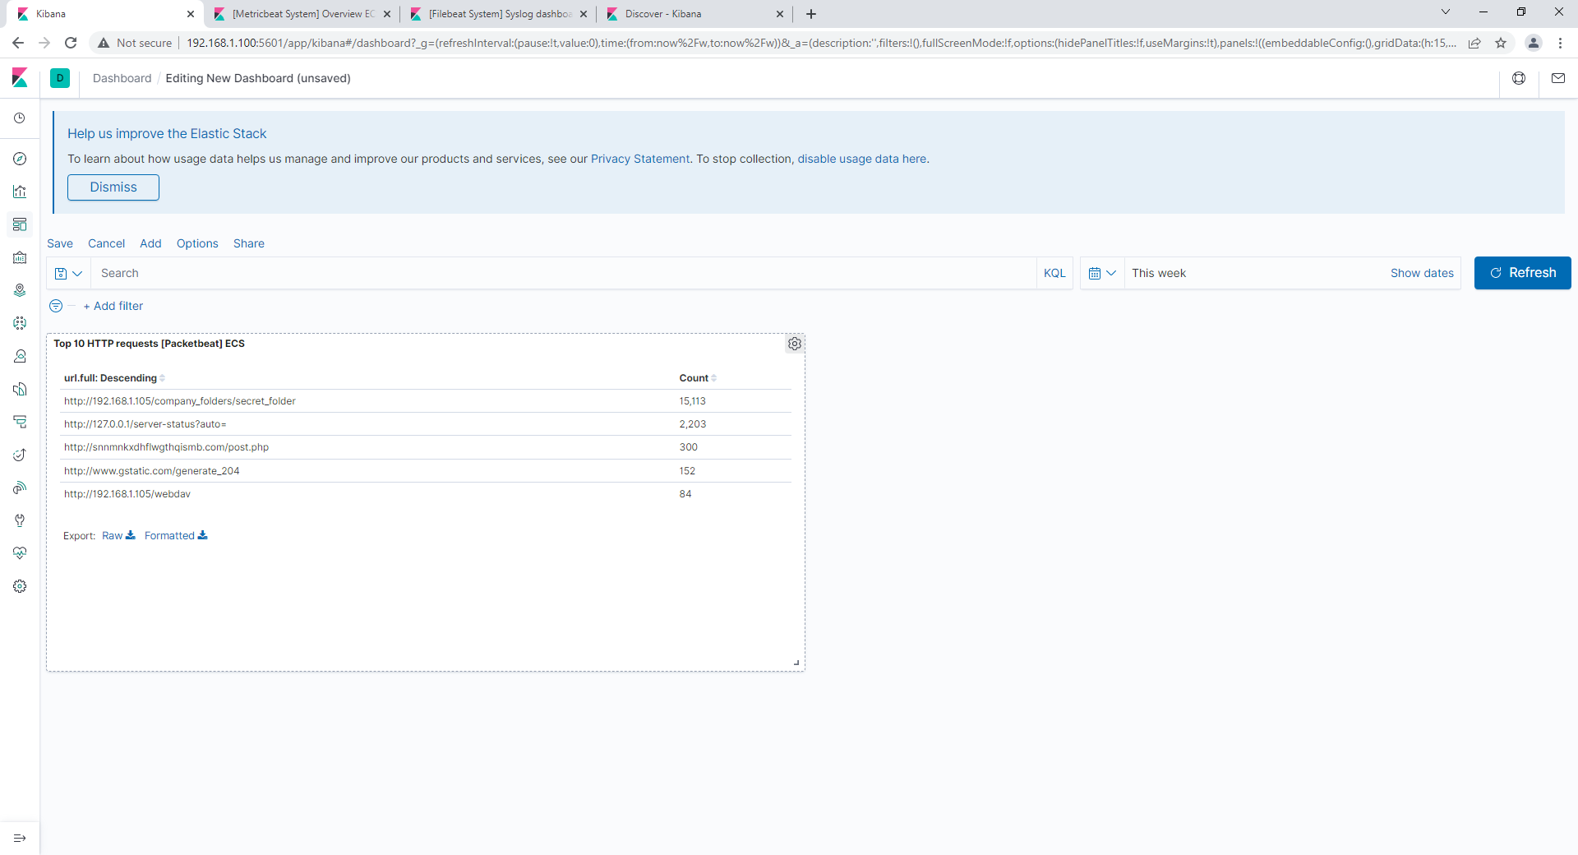
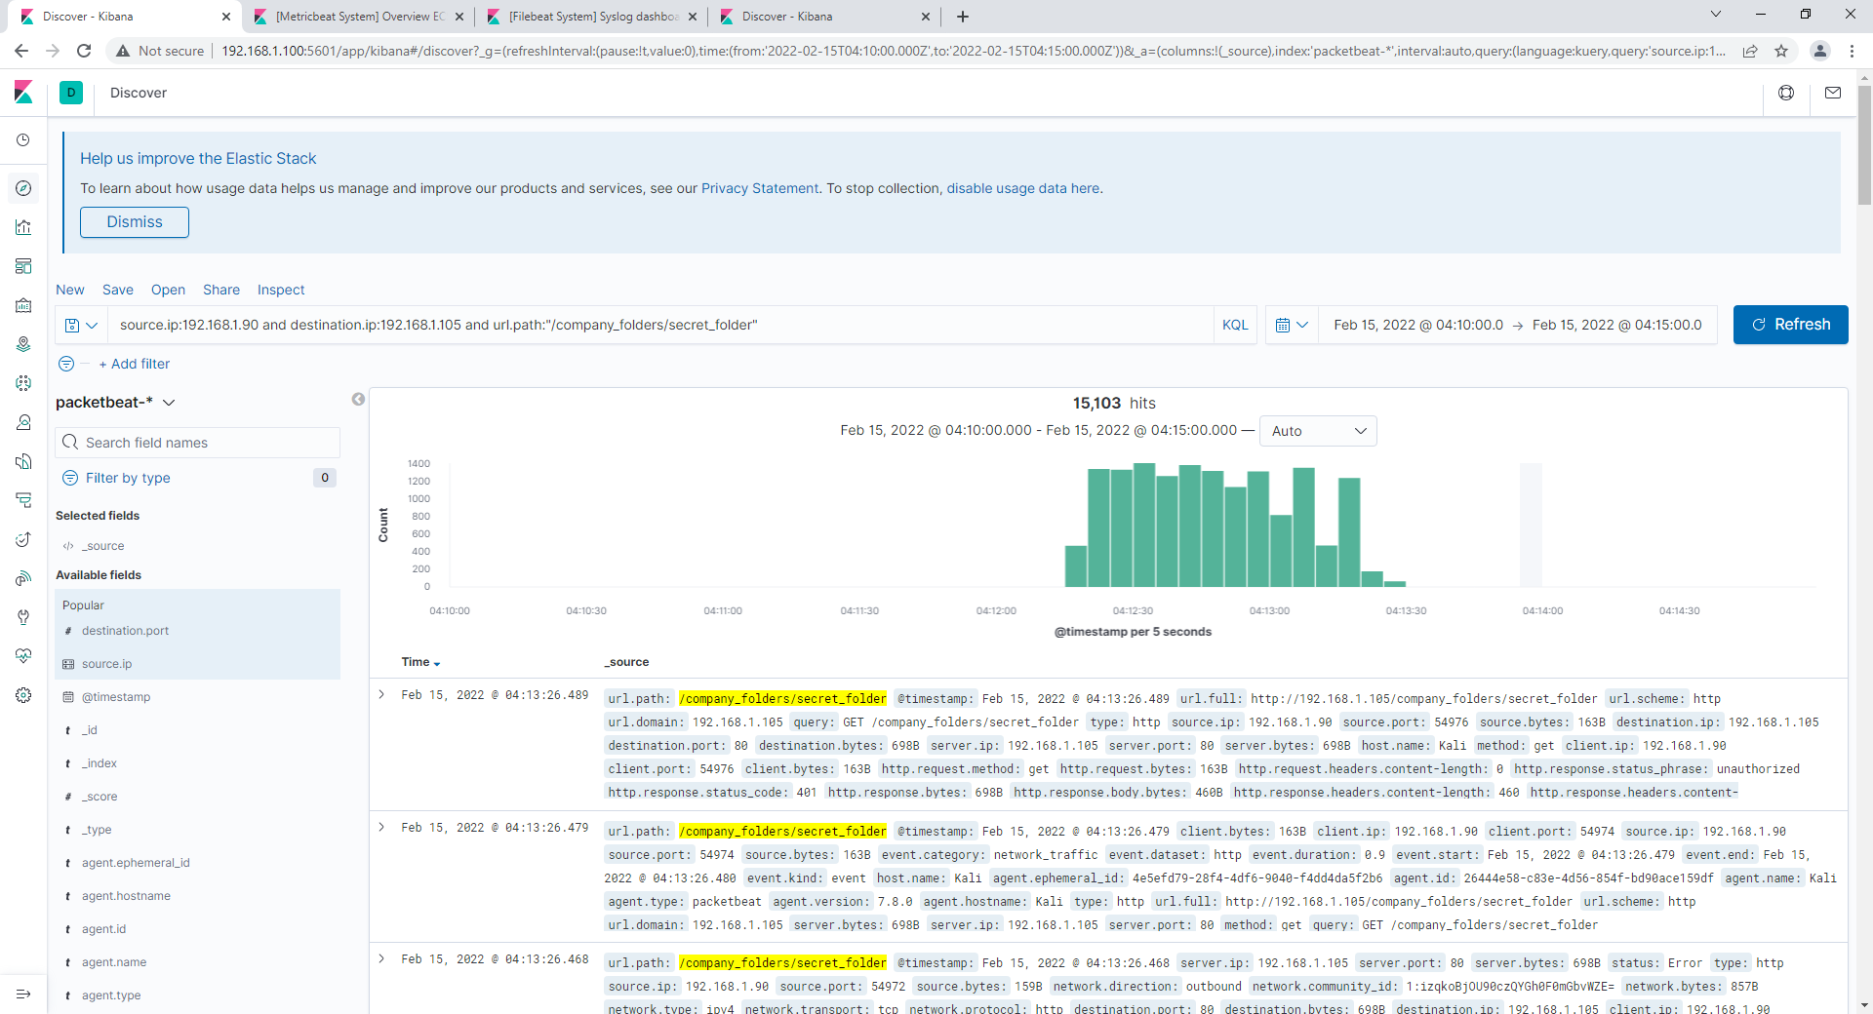
Analysis: Finding the Request for the Hidden Directory
The requests for the hidden directory occurred at 04:13:26 UTC on 2/15/2022, there were 15,113 requests sent
The secret folder was requested, this was Ashton’s folder which contained Ryan’s username and password hash

Slide 19
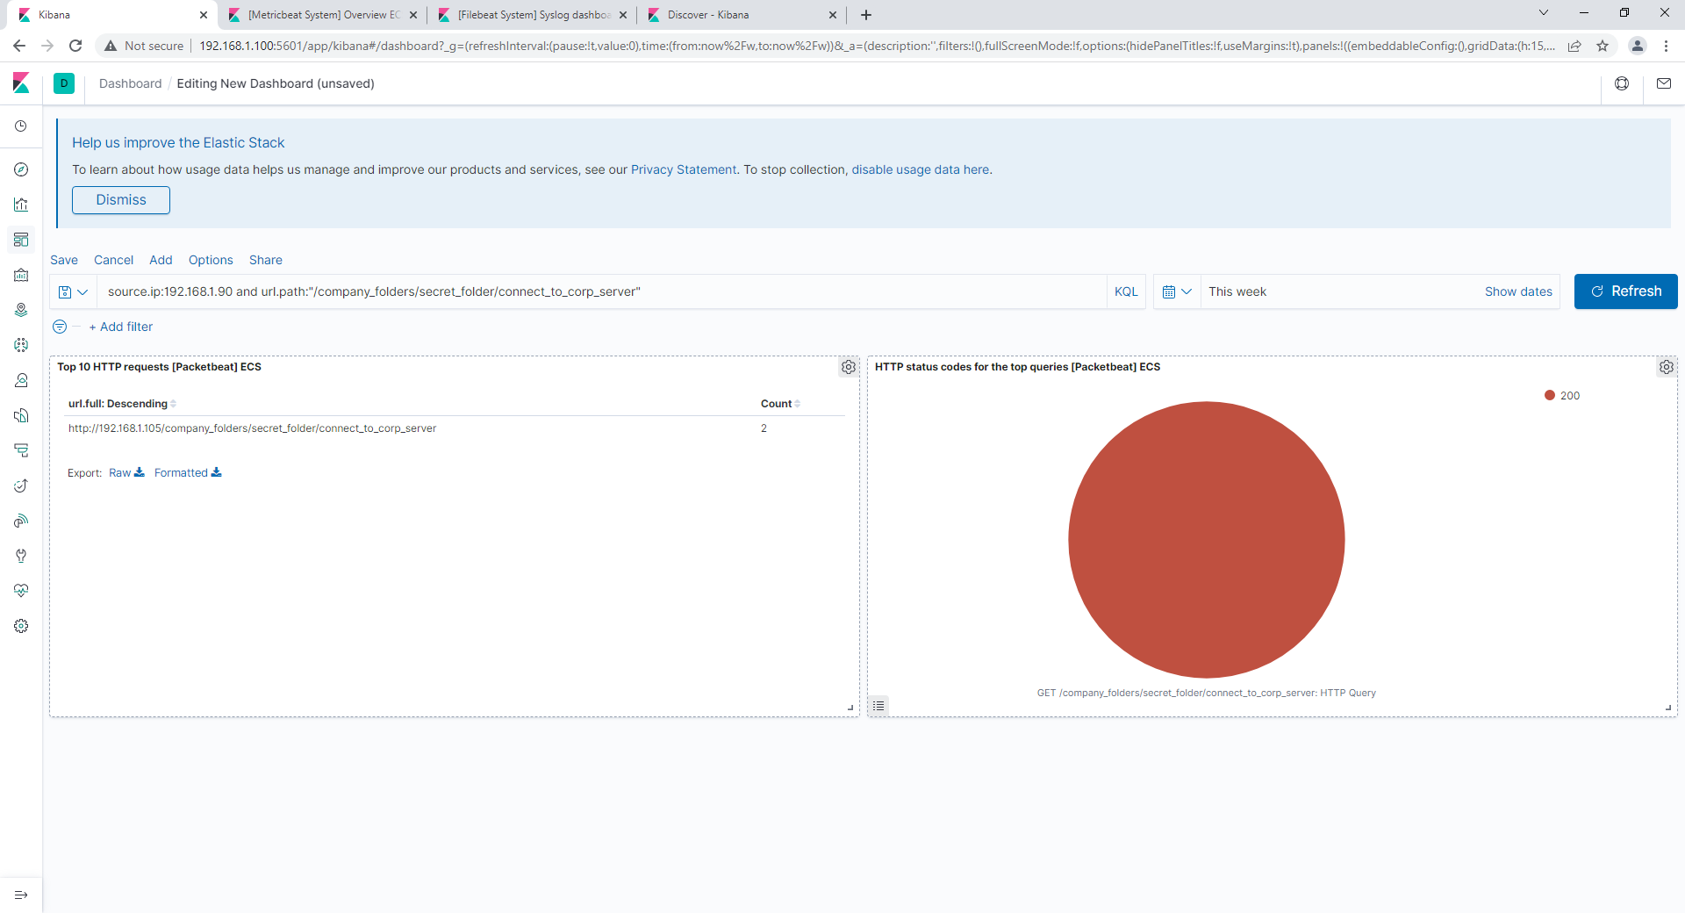
Analysis: Uncovering the Brute Force Attack
There were 15,103 requests made in the attack
There were 2 attacks that successfully routed into the secret folder, returning a 200 status code, the other 15,101 were unsuccessful

Slide 20
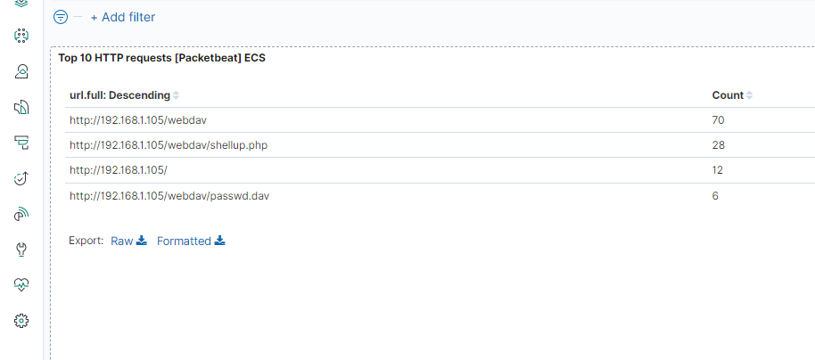
Analysis: Finding the WebDAV Connection
There were 70 requests made into the webdav directory, 28 into the shellup.php file and 6 into the passwd.dav file
The passwd.dav file was requested 6 times, the shellup.php file was requested 28 times, this was the malicious payload that was created with msfvenom and uploaded into the webdav directory

Slide 21
Blue Team
Proposed Alarms and Mitigation Strategies
‹#›

Slide 22
Mitigation: Blocking the Port Scan
What kind of alarm can be set to detect future port scans?
An alarm that triggers when traffic from a single IP address attempts to access multiple ports
What threshold would you set to activate this alarm?
Any scan from an IP address that hits multiple ports (5 or more) in under 1 second
What configurations can be set on the host to mitigate port scans?
Configure the system to block all access to ports, unless it is determined to be a company need. Set up monitoring to alert security in the event unusual traffic is detected
Describe the solution. If possible, provide required command lines.
Installing firewalls to prevent unauthorized access, making sure all alarms trigger for suspicious activity
Use firewall settings through the ufw command to customize port access

Slide 23
Mitigation: Finding the Request for the Hidden Directory
What kind of alarm can be set to detect future unauthorized access?
Trigger an alarm if anyone outside of the local IP attempts to access the hidden directory, also triggers if multiple attempts are made to access the hidden directory
What threshold would you set to activate this alarm?
Any outside traffic attempting to access the hidden directory
What configuration can be set on the host to block unwanted access?
Setting access to only allow internal access from internal IP address, also securing data to make sure it needs a private key (or other encryption) to access via encrypting the hidden data
Describe the solution. If possible, provide required command lines.
Update config files to only allow safe IPs
Use preferred data encryption method to keep directory information safe

Slide 24
Mitigation: Preventing Brute Force Attacks
What kind of alarm can be set to detect future brute force attacks?
Trigger alarm if multiple attempts are made to access the server with the same username in as short period of time
What threshold would you set to activate this alarm?
10 failed attempts within 15 minutes should trigger this alarm in a regular situation
What configuration can be set on the host to block brute force attacks? (Solutions included as well)
Strong Password requirements for all accounts
System Lockout after 10 failed attempts in 15 minutes
For high level users, multi-factored authentication used
Frequent required password changes

Slide 25
Mitigation: Detecting the WebDAV Connection
What kind of alarm can be set to detect future access to this directory?
Similar to the hidden directory, disable WebDav connection from outside IP addresses
What threshold would you set to activate this alarm?
Any attempt to access WebDAV from an outside IP address
What configuration can be set on the host to control access?
Update IP address access to WebDav to only allow internal traffic.
Requiring strong passwords to access the WebDav directory to prevent easy access through a password cracking tool.
Describe the solution. If possible, provide the required command line(s).
Password requirements detailed in previous steps
Updating the config files to only allow safe IPs

Slide 26
Mitigation: Identifying Reverse Shell Uploads
What kind of alarm can be set to detect future file uploads?
An alert if any unlisted IP uploads any file to the webserver, or if any flagged file type is uploaded to the webserver
What threshold would you set to activate this alarm?
Trigger if a single unlisted IP or flagged file type is uploaded
What configuration can be set on the host to block file uploads?
Confirming source and filetype for all uploaded files
Monitoring any sort of executable or script file that is being uploaded to the system
Confirm only authorized users can make uploads
Describe the solution. If possible, provide the required command line.
Constant monitoring of created alerts
Access to upload data is monitored and controlled regularly to make sure no files are uploaded by unauthorized sources

